Slide 1
Population-Based Cancer Research Using the Oncology Module Querying the Oncology Module: ATLAS and SQL

Slide 2
Block 1 Recap
1
Cancer Disease Model
Cancer Diagnosis: Base Diagnosis + Diagnostic Modifiers
(One-to-many connection between them)
Cancer Treatment Model
Composite Level (Treatment Episodes) or Individual Level (standard OMOP)
Cancer Episode Model
Continuous periods of disease or treatment with distinct clinical meaning
Composed of multiple events
Essential for conducting cancer research
2
3

Slide 3
Population-Based Cancer Research Using ATLAS-Overview
Cancer module provides details necessary to accurately define cohorts in ATLAS
ATLAS does not support
The link between base diagnosis and modifiers
Episodes (Disease and Treatment)

Slide 4
Population-Based Cancer Research Using ATLAS-Overview
Cancer module provides details necessary to accurately define cohorts in ATLAS
ATLAS does not support
The link between base diagnosis and modifiers
Episodes (Disease and Treatment)
How to use the Module in ATLAS:
Temporal relationship between conditions (Condition Domain) and modifiers (MEASUREMENT Domain) to define the cohorts
Procedure and Drug Domain concepts to identify individual treatments

Slide 5
Population-Based Cancer Research Using ATLAS
Define cohorts:
Metastatic cancer
Cancer with metastasis to a certain site
Cancer with aggressive histology
Cancer with specific genetic variation
Cancer with lymph nodes involvement
Cancer with a specific stage
Treated cancer
Death

Slide 6
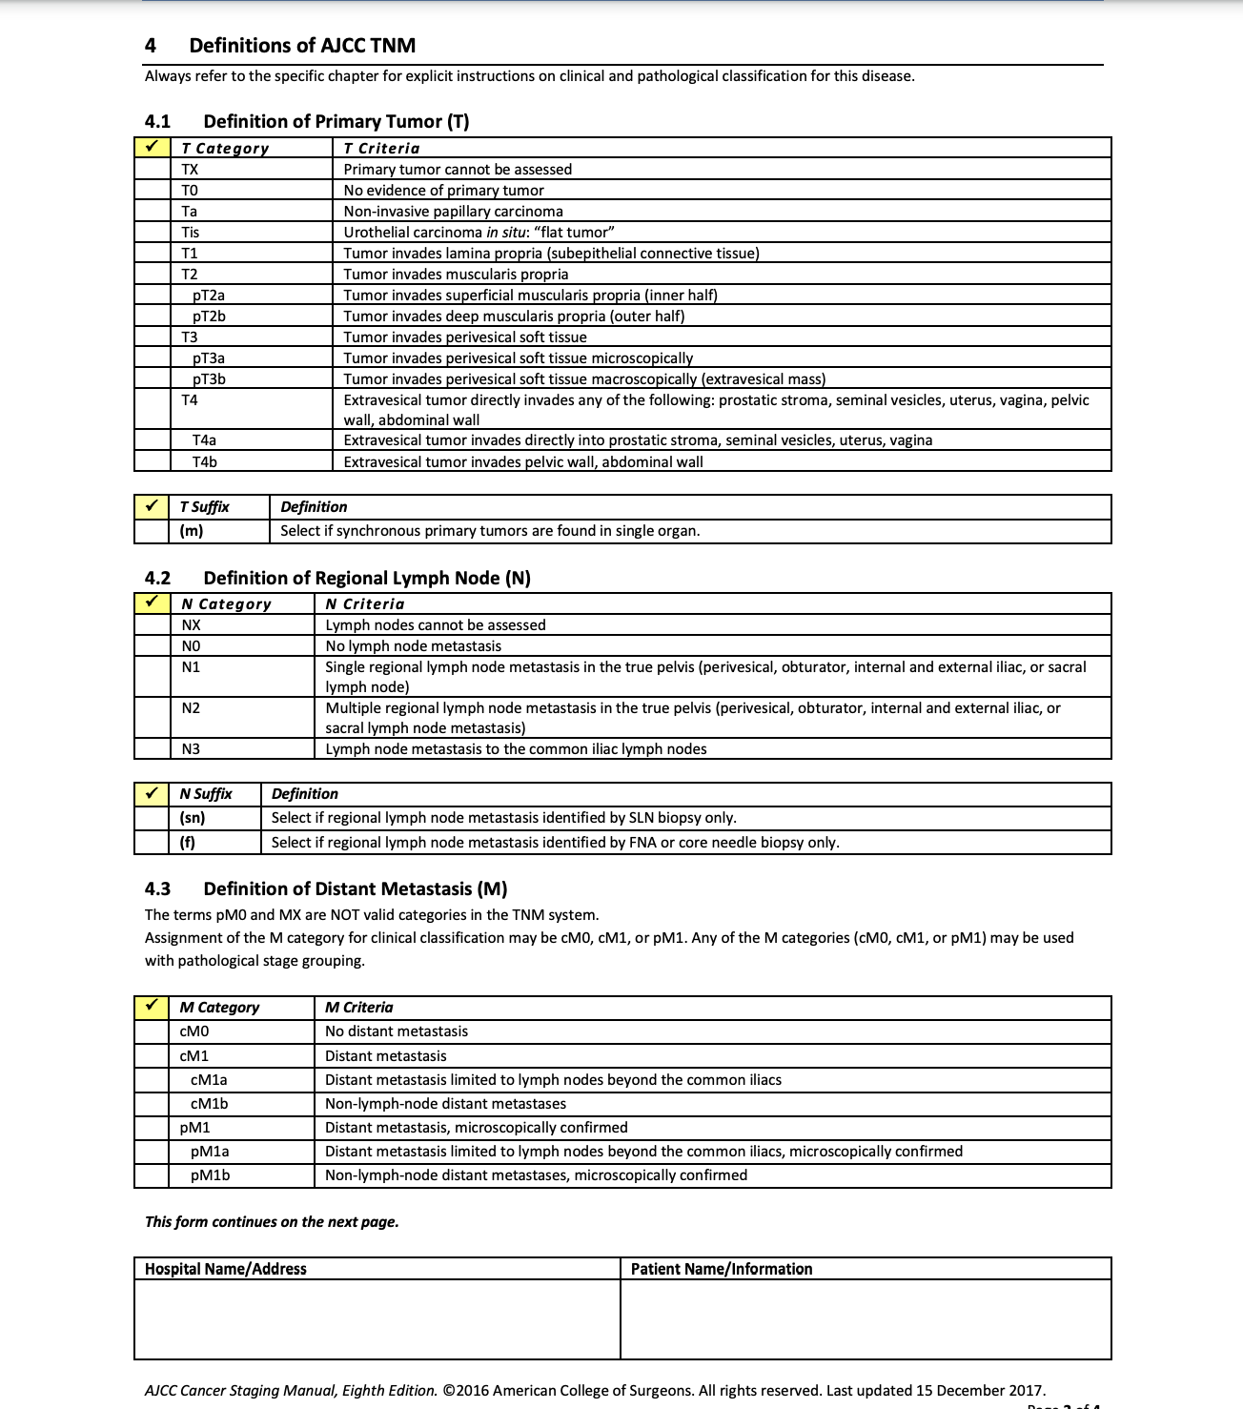
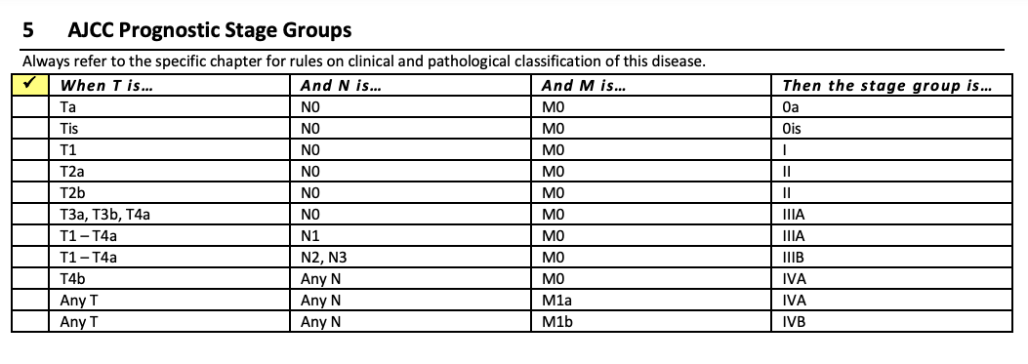
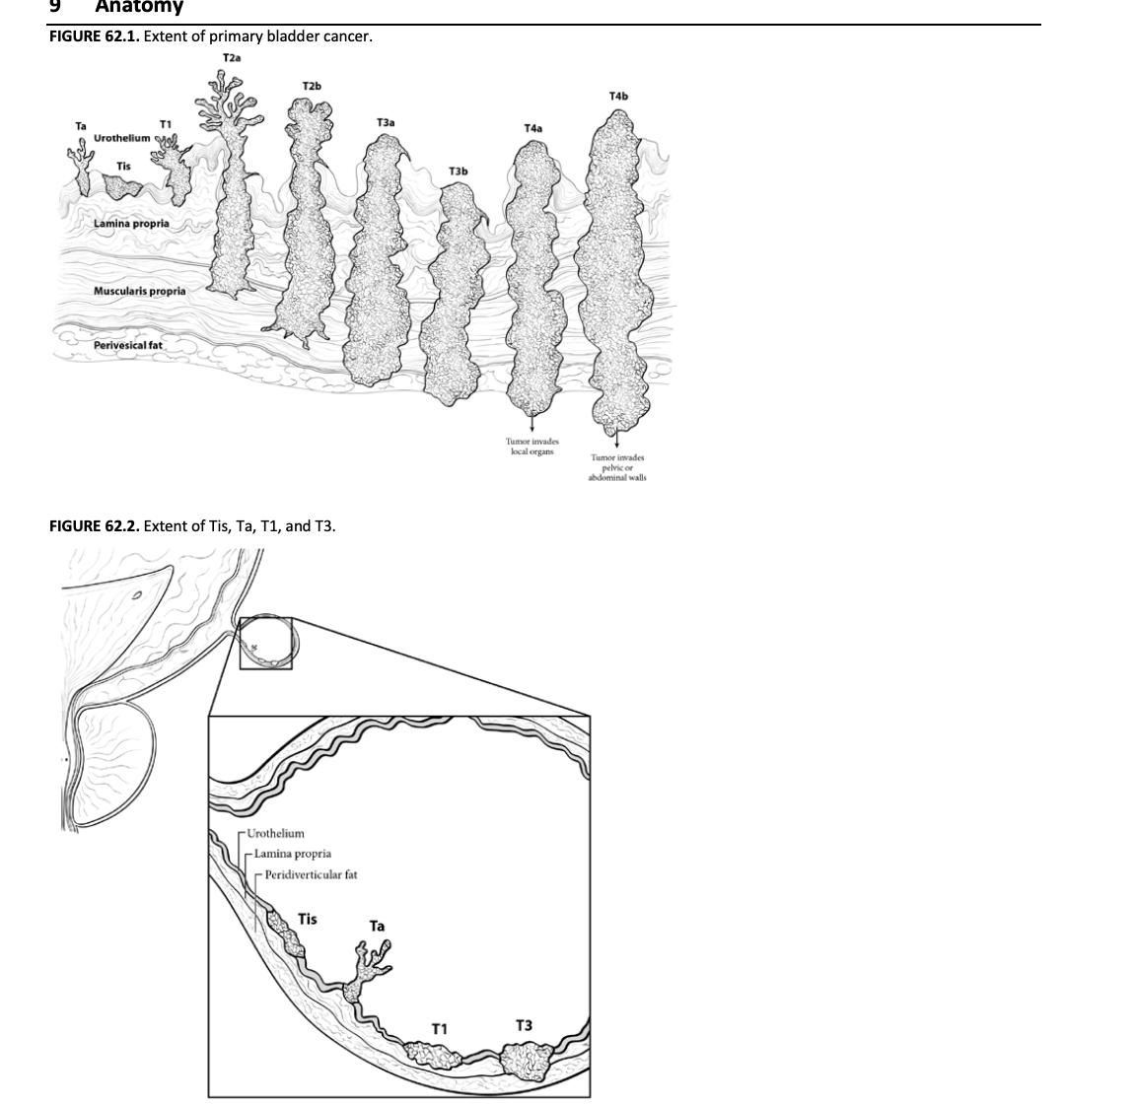
Cheat Sheet: Bladder Cancer Staging
Amin MB, Edge SB, Greene FL, et al, eds. AJCC Cancer Staging Manual. 8th ed. New York: Springer; 2017.

Slide 7
Metastasis: Metastatic Bladder Cancer
Define a cohort of adult patients with metastatic bladder cancer

Slide 8
Metastasis: Metastatic Bladder Cancer
Define a cohort of adult patients with metastatic bladder cancer
Cohort entry event (index date)

Slide 9

Metastasis: Metastatic Bladder Cancer
Define a cohort of adult patients with metastatic bladder cancer
Inclusion criteria:
$≥18$years old
Bladder cancer before or at index date
Cohort entry event (index date)

Slide 10
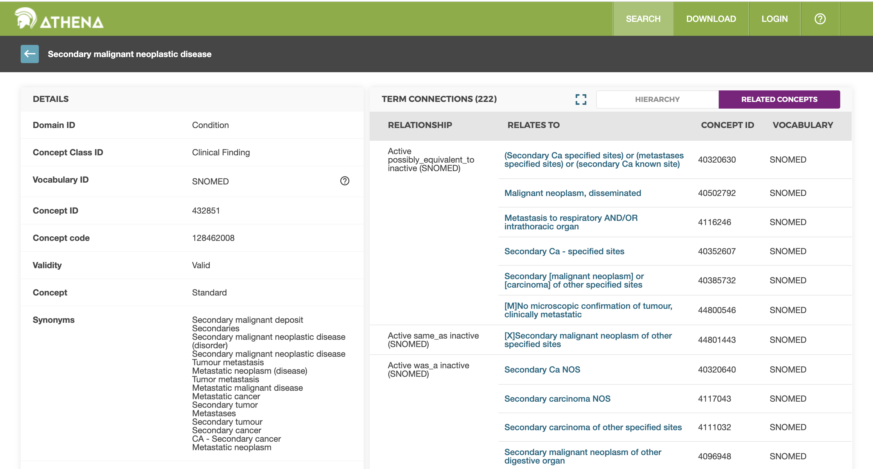

Slide 11
Metastasis: Metastatic Bladder Cancer
Define a cohort of adult patients with metastatic bladder cancer
Inclusion criteria:
$≥18$years old
Bladder cancer before or at index date
1) Condition occurrence of “secondary malignant neoplastic disease”
(Concept ID= 432851)
2) Measurement of:
Stage: Bladder Cancer M1 (Concept ID: 1538151 OR OR 1538345 OR 1538683 OR 1539249 OR 1538168 OR 1537976)
Domain: Measurement, Class: AJCC Category
Metastasis: (Concept ID: 36769180)
Domain: Measurement, Class: Metastasis
OR

Slide 12
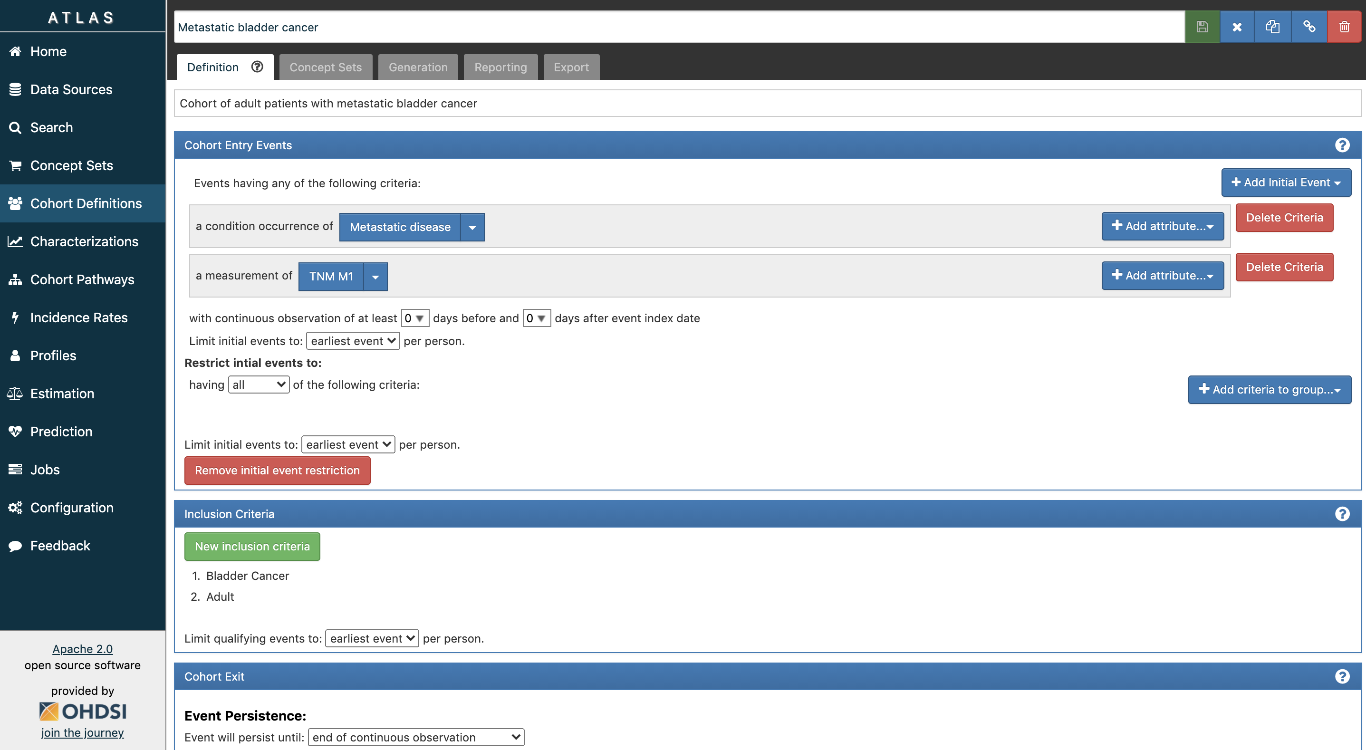

Slide 13

Metastasis to a Certain site: Metastasis to Liver
Define a cohort of adult bladder cancer patients with liver metastasis
Inclusion criteria:
$≥18$years old
Bladder cancer before or at index date
1) Condition occurrence of “secondary malignant neoplasm of liver” (Concept ID=198700)
2) Measurement of liver metastasis (Concept ID=36770544)
Domain: Measurement, Class: Metastasis
OR

Slide 14

Metastasis to a Certain Site: High-Grade Cancer
Define a cohort of adult patients with high-grade bladder cancer
Inclusion criteria:
$≥18$years old
1) Condition of “primary malignant neoplasm of bladder” (Concept ID=196360) (index)
2) Measurement: high-grade (Concept ID= 36769410) on index xxx days before/after index date
Domain: Measurement, Class: staging/grading
AND

Slide 15

Specific Genetic Variation: FGFR3 S249C Mutation
Define a cohort of adult metastatic bladder cancer patients with FGFR3 S249C mutation
Inclusion criteria:
$≥18$years old
Bladder cancer before or at index date
Metastasis (index)
Condition occurrence of secondary malignant neoplasm
Measurement of M1 stage or metastasis
Biomarker
Measurement of FGFR3 S249C (Concept ID= 35988216) on or x days before/after index date
Domain: Measurement, Class: Protein variant
AND

Slide 16

Cancer with Nodal Involvement: Regional Lymph Node Involvement
Define a cohort of adult bladder cancer patients with regional lymph node involvement
Inclusion criteria:
$≥18$years old
Bladder cancer before or at index date
1) Measurement of regional lymph node (Concept ID=36769269) (index)
Domain: Measurement, Class: Nodes

Slide 17

Cancer with Specific Stage: Stage IIIb
Define a cohort of adult patients with stage IIIb (AnyTN2/N3M0) bladder cancer
Inclusion criteria:
$≥18$years old
Bladder cancer before or at index date
Measurement of
1) Node: pN2 OR pN3 TNM Finding (Concept ID= 1539341 OR 1537967) at index
2) Metastasis: cM0 TNM (Concept ID= 1538871) at index
Domain: Measurement, Class: AJCC Category
AND

Slide 18

Treated Cancer: Bladder Cancer Treated with Gemcitabine
Define a cohort of adult patients with metastatic bladder cancer patients received gemcitabine
Inclusion criteria:
$≥18$years old
Metastasis before or at index date
Bladder cancer before or at index date
Drug exposure of gemcitabine (Concept ID= 21601439) (index)
Domain: Drug, Class: ATC

Slide 19

Death
Define a cohort of adult metastatic bladder cancer patients who died during the follow-up
Inclusion criteria:
$≥18$years old
Bladder cancer before or at index date
Metastasis (index)
Condition occurrence of secondary malignant neoplasm
Measurement of M1 stage or metastasis
Death occurrence: any death after index date
AND

Slide 20

Oncology Extension SQL

